Slide 1

Using ASAP for Single-Cell analysis
2023 SIB Course (Online)
Vincent Gardeux
Deplancke’s Laboratory of Systems Biology and Genetics
Ecole Polytechnique Fédérale de Lausanne (EPFL), Switzerland

Slide 2


Single-cell RNA-seq
Each black circle is a cell, each colored dot is a transcript, colors encode transcript of the same gene
Macaulay IC, Voet T (2014) PLoS Genet

Slide 3

Single-cell ‘omics
2009 – Single-cell RNA-seq
2009 – Mass cytometry (CyTOF)
2014 – Single-cell Western Blot³
(New) 10x spatial proteomics
SC
transcriptomics
2015 – Single-cell DNA & RNA-seq: scG&T-seq¹
SC proteomics
Single-cell
SC genetics
Vistain & Tay, Trends in Biochemical. Sci.
2011 – Single-cell DNA-seq
SC
metabolomics
SC
epigenomics
2016 – Single-cell RNA-seq & Methylome: scM&T-seq²
(New) 10x ATAC & RNA-seq
2013 – scRRBS (methylome)
2015 – Single-cell ATAC-seq
¹Macaulay et al. Nature methods, 2015
²Angermueller et al. Nature methods, 2016
³Hugues et al. Nature methods, 2014

Slide 4
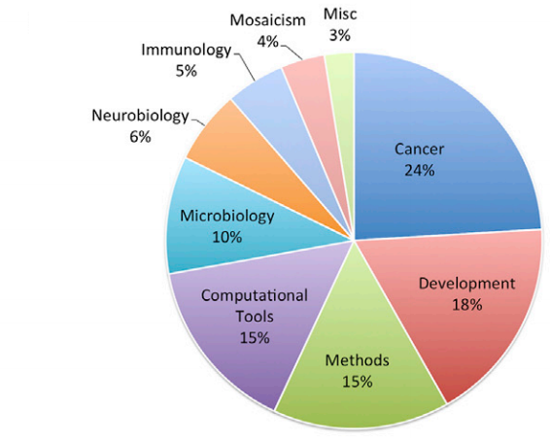
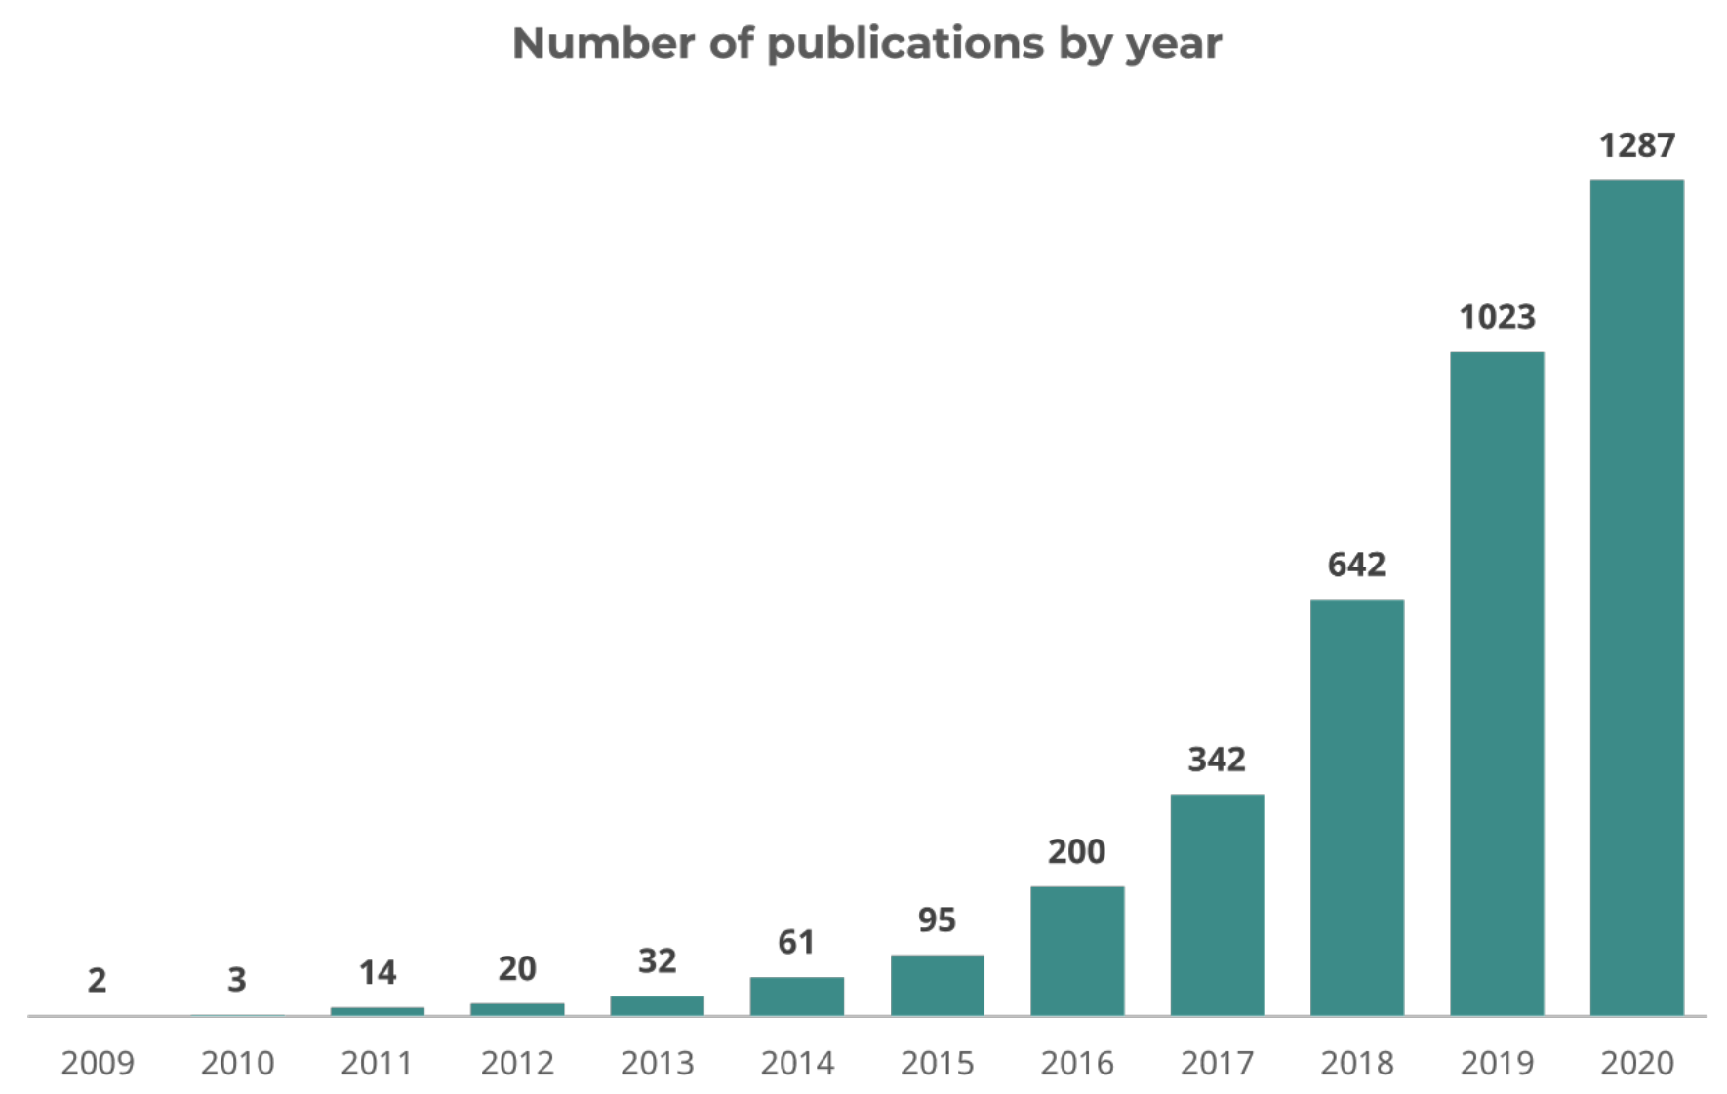
Single-cell genomics applications
Wang, Y., & Navin, N. E. (2015). Advances and applications of single-cell sequencing technologies. Molecular cell
Angerer & Theis (2017). Single cells make big data: New challenges and opportunities in transcriptomics. Current opinion in Systems biology

Slide 5
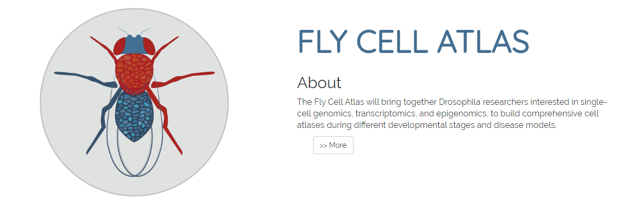

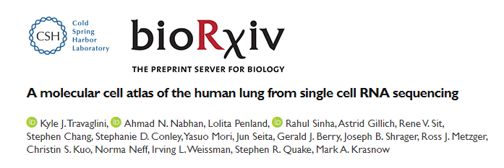


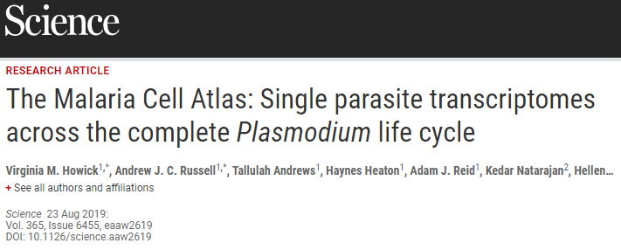
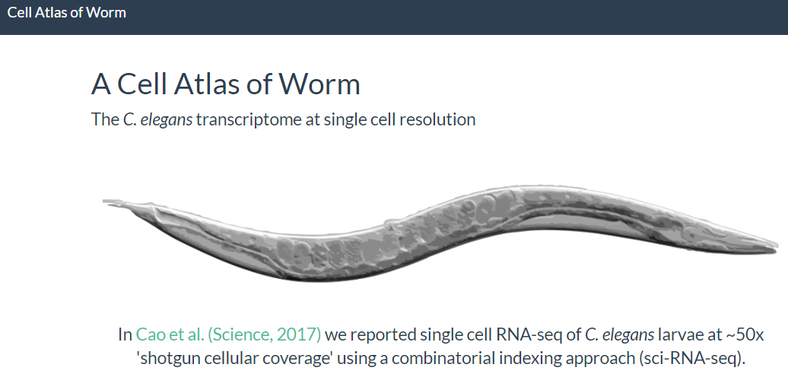
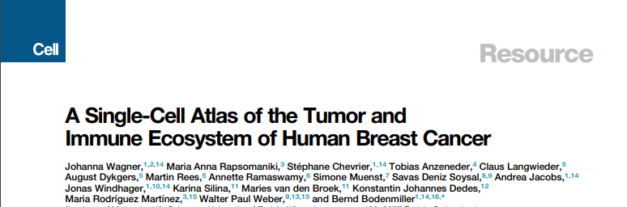
scRNA-seq applications – Creating XXX cell atlases

Slide 6
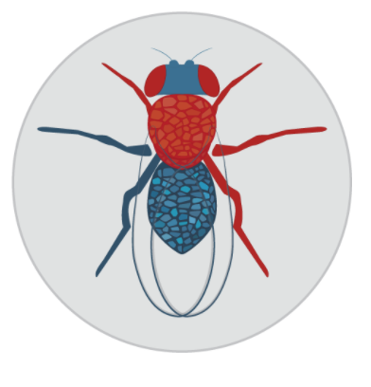
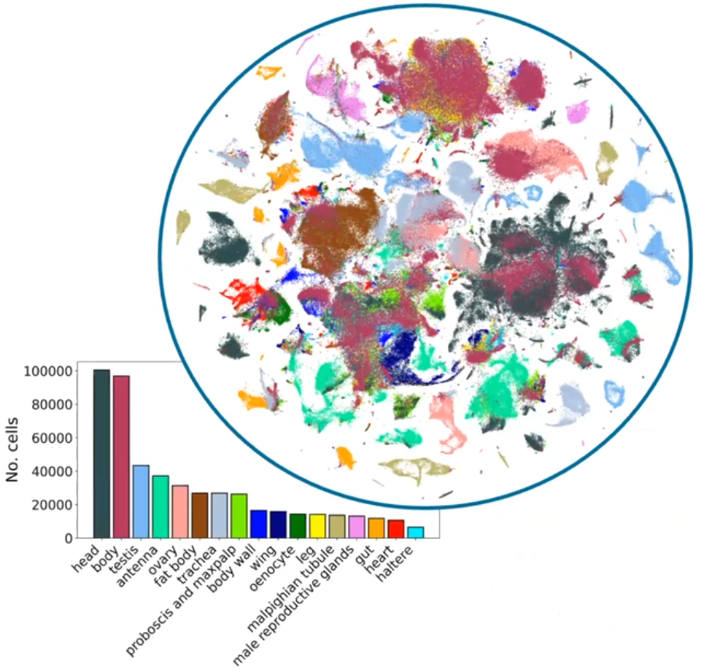


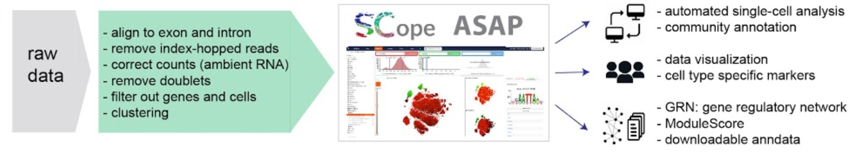

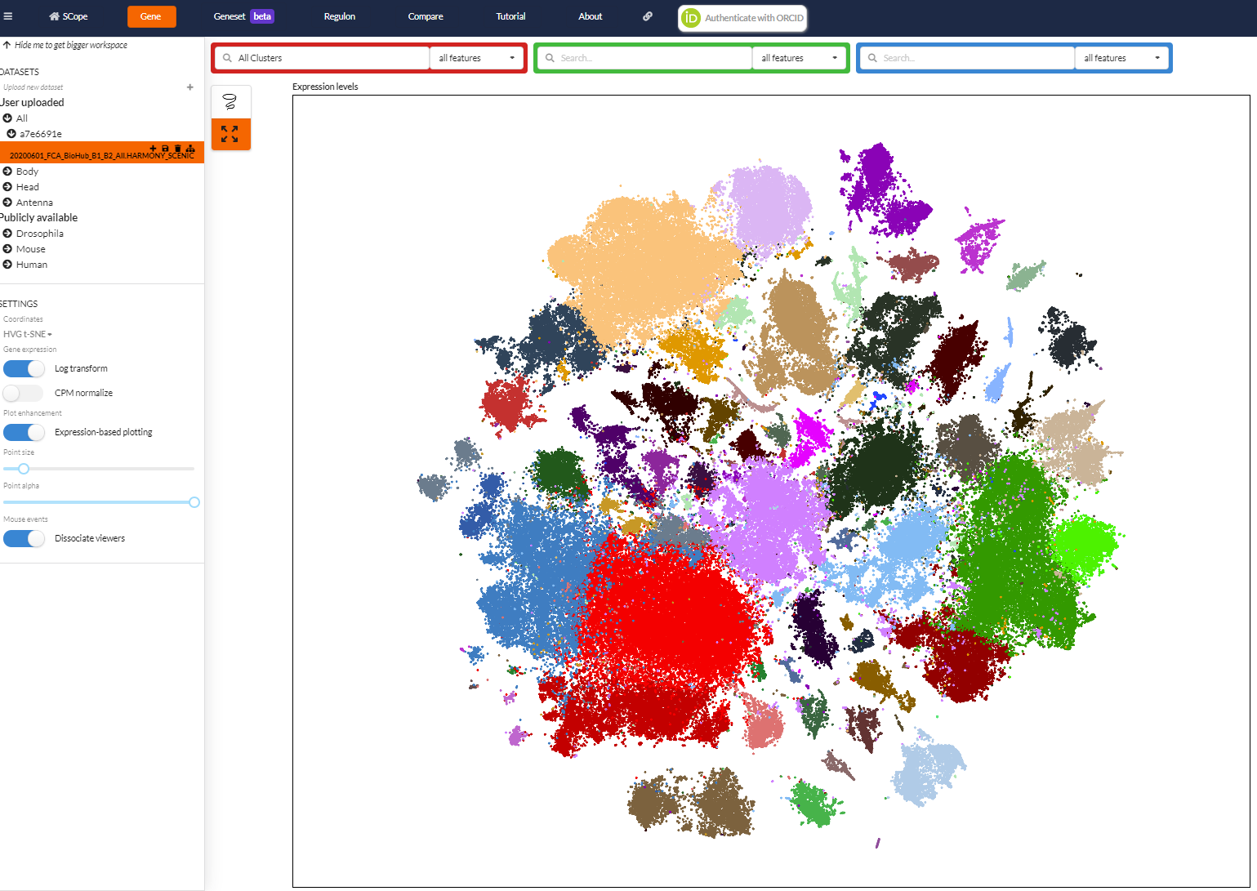
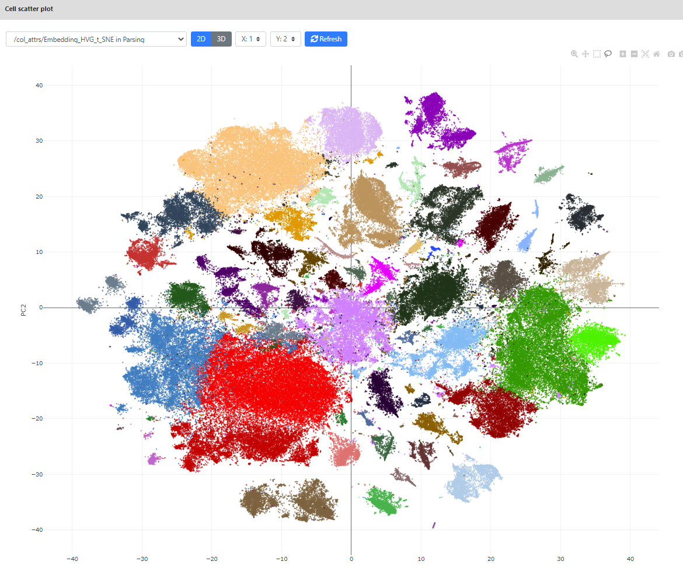

One of the latest atlases: the Fly Cell Atlas
https://flycellatlas.org/
A single-cell RNA-seq atlas of the drosophila melanogaster of 15 tissues, recapitulated in body and head
Data made available through two interactive portals: SCope and ASAP
63 10x runs
38 billion reads
570k cells using 10x
10k cells using SMART-Seq2
And also in
Data exchange
(.loom files, sub-clusters)
https://scope.aertslab.org/
https://asap.epfl.ch/
Li et al., Science, 2022

Slide 7
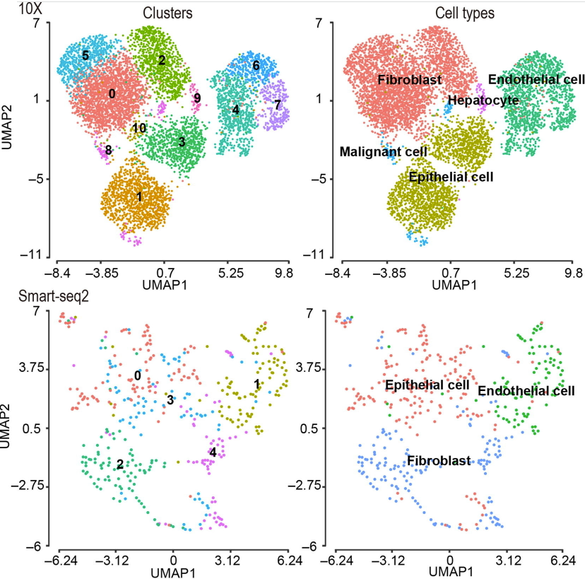
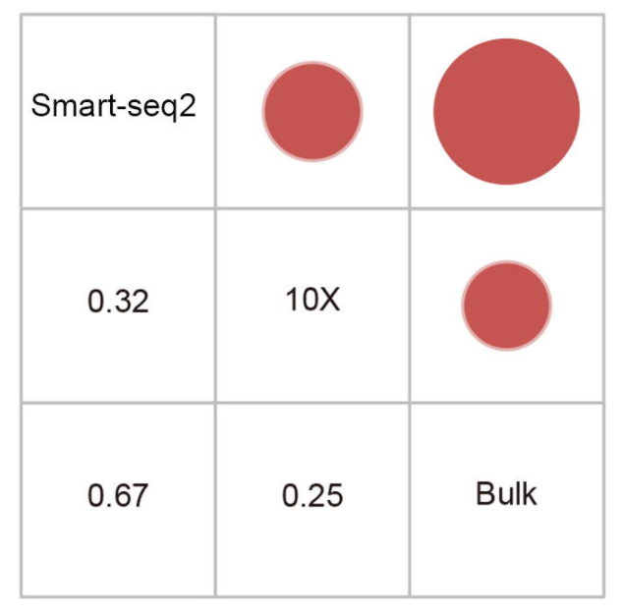
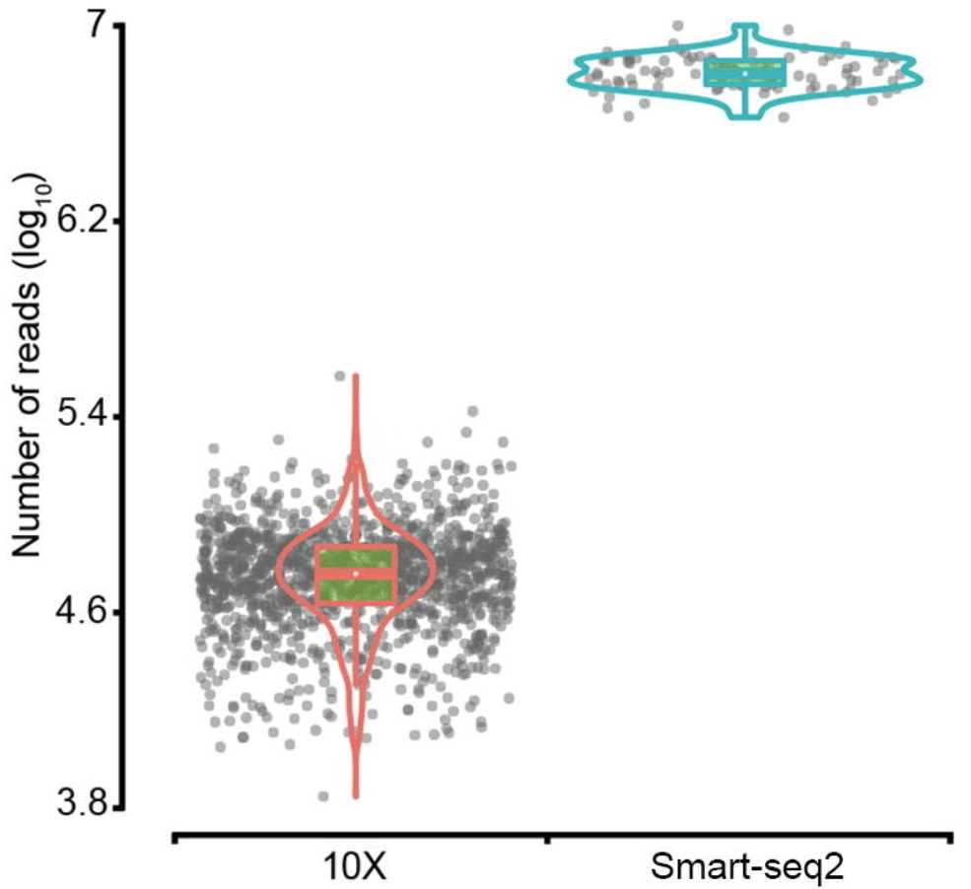
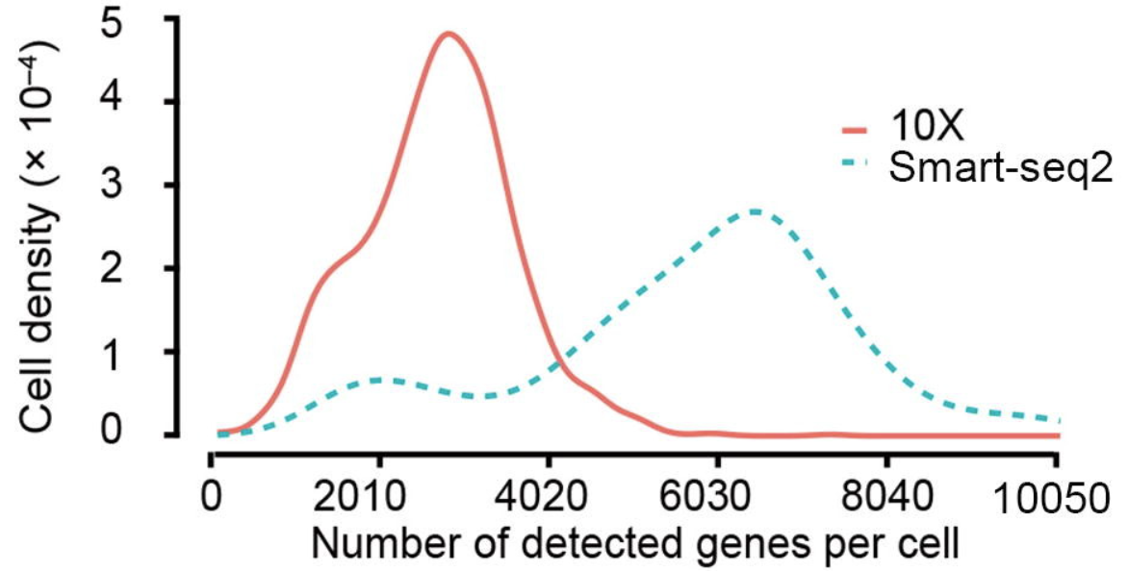
Which protocol to use? Two main protocols currently in use: Smart-seq2 vs 10x
X. Wang, Y. He, et al, Genomics, Proteomics & Bioinformatics, 2021

Slide 8


Community needs: « I want to do single-cell ! »
I finally got good
single-cell data!!

Slide 9

Community needs: « But how do I analyze single-cell data? »
??
Same as bulk data pipelines?
Which tools to use?
Typical bottleneck

Slide 10
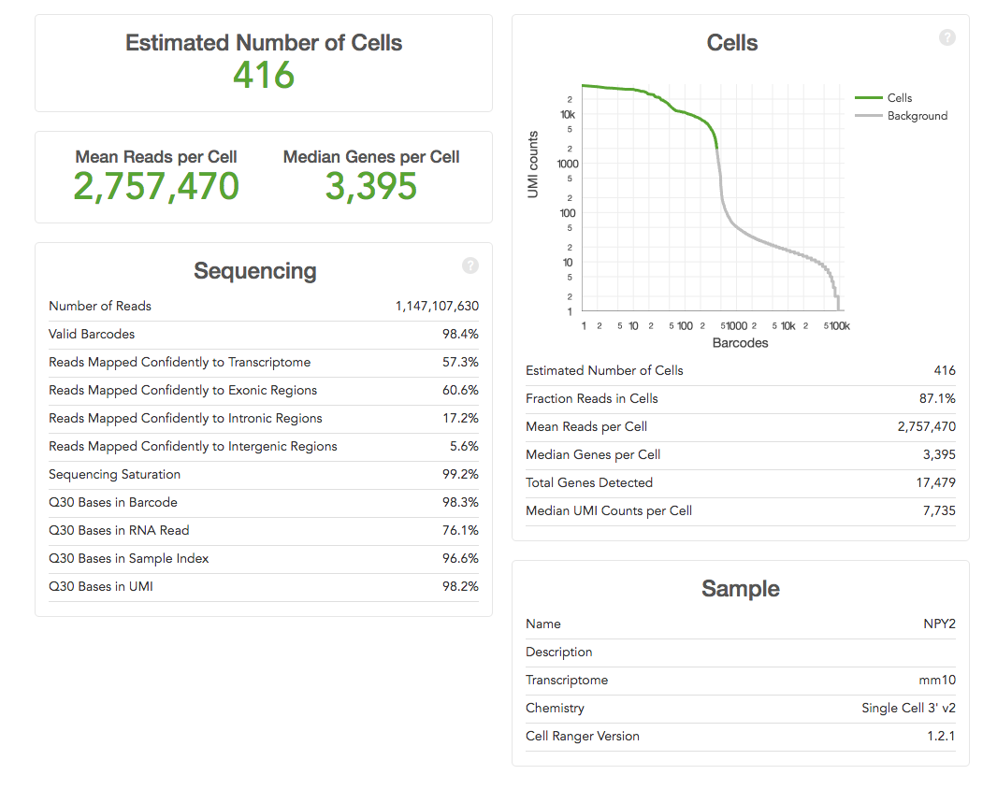

scRNA-seq analysis pipeline
Mapping to reference genome
PREPROCESSING
Demultiplexing & QC
Single-cell specific:
Barcode demultiplexing
UMI counting
Filtering of cell
Read/transcript matrix
(raw counts/UMI or normalized data)
DOWNSTREAM ANALYSIS
Quality control & filtering (II)
Normalization, noise removal
Single-cell specific:
Drop-out handling
Cell-cycle removal
Etc.
Study-specific downstream analyses
to generate new biological insight
Cell type identification
Cell type characterization
Gene network analysis
Kinetics of transcription

Slide 11
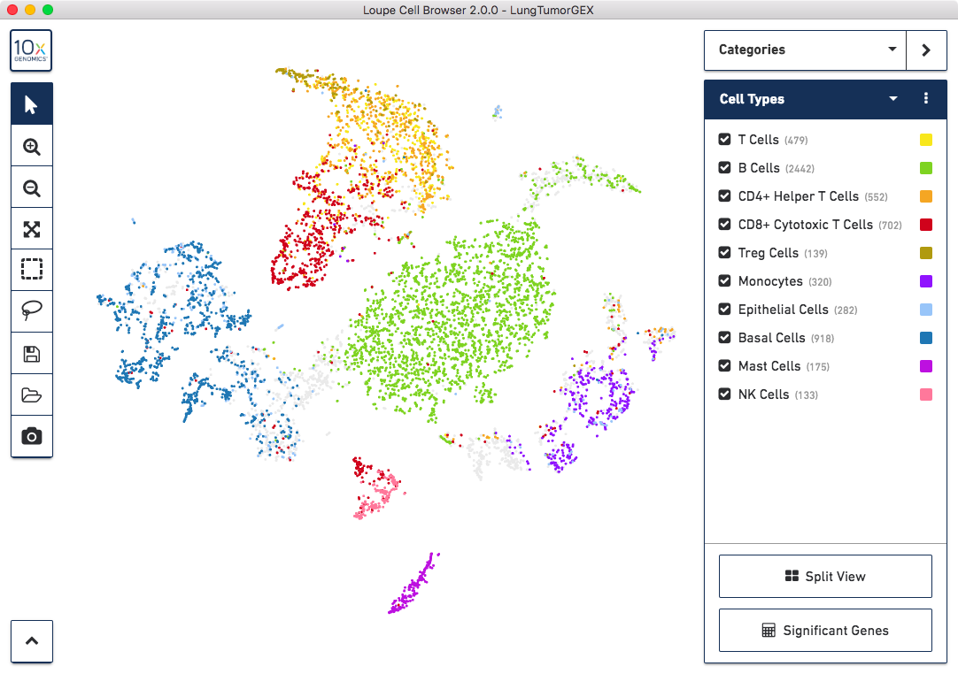
scRNA-seq analysis pipeline
Quality control & filtering (I)
"Black box" fixed pipeline?
e.g. 10x cell Ranger pipeline
+ Loupe Visualization
Mapping to reference genome
Quality control & filtering (II)
Normalization, noise removal
Study-specific downstream analyses
to generate new biological insight

Slide 12
scRNA-seq pipeline may not be applicable to all datasets
Solutions
Standardized but parametrizable pipelines (e.g. Seurat, scanpy)
Probably best for bioinformaticians
User-friendly automated analysis portals (e.g. ASAP, FastGenomics, …)
=> Good first glance at results for bioinformaticians. Sufficient for non-bioinformaticians.

Slide 13


Single-cell analysis pipelines
Two main pipelines for analyzing single-cell data:
Seurat ( in R ) from Satija lab (2015). Now in v4
SCANPY (in Python) from Theis lab (2018). Now in v1.8

Slide 14


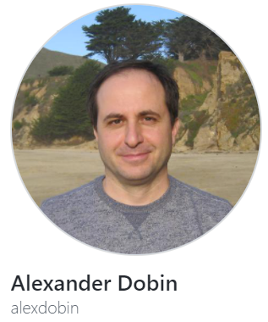


Single-cell RNA-seq analysis pipelines
The “Full workflow”, i.e. from the sequencing machine, is the following:
.fastq
Mapping to reference genome
Single-cell specific:
Barcode demultiplexing
UMI counting
Filtering of cells (e.g. empty droplets)
.bam
Demultiplexing and
Quality control (QC)
PREPROCESSING
UNIX / bash
.txt / .csv
.h5 / .loom
Read / transcript matrix
(raw counts / UMI)
QC and filtering
Single-cell specific:
Filtering doublets?
Removing covariates? (cell-cycle)
etc.
DOWNSTREAM ANALYSIS
Normalization, noise removal
R / Python
Study-specific downstream analyses
to generate new biological insights

Slide 15

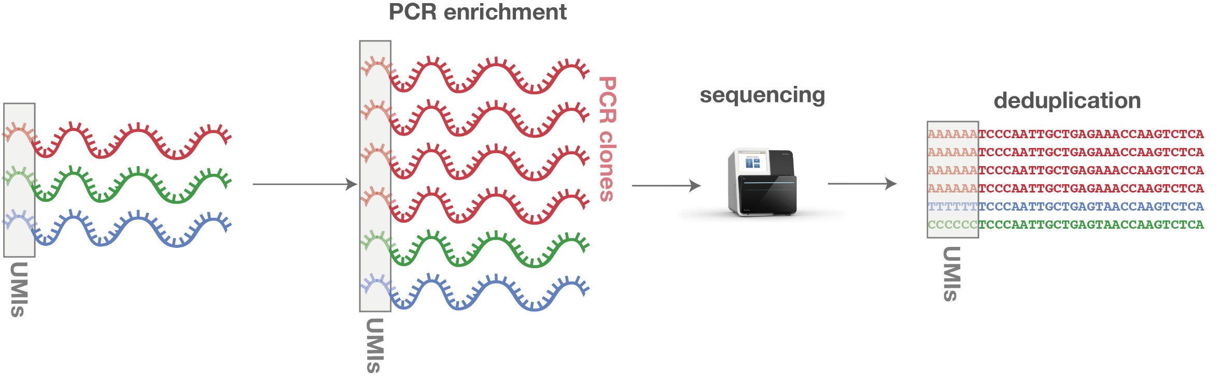
Before we start, one important concept to understand: UMI
With standard bulk RNA-seq we only have read count matrix. We can try removing PCR duplicates by removing reads that fall exactly at the same position (Picard tool)
Unique Molecular Identifier (UMI) were designed to remove amplification bias
UMIs are random barcodes that are attached to the fragments prior amplification
mRNA
AA…AAA
TT …TTT
UMI
Cell_ID
cDNA
6 identical sequences
3 unique input fragments
© ecSeq Bioinformatics

Slide 16

Before we start, one important concept to understand: UMI
Unique barcodes (UMIs) associated with all reads are mapped to a given gene
UMIs are “collapsed” at each unique position
Individual transcripts can thus be detected in the final output by removing the duplicated barcodes/UMIs
Reduce the technical noise
Simpler statistical models (vs read counts)
Better approximation of duplicates as compared to standard Picard/Samtools tools (e.g. for variant calling)
Cell 1:
Example: Read count matrix
Example: UMI count matrix
Gene 1
Gene 2
Gene n
 | Cell 1 | Cell 2 | …
Gene 1 | 15 | … | …
Gene 2 | 11 | … | …
… | … | … | …
Gene n | 8 | … | …
 | Cell 1 | Cell 2 | …
Gene 1 | 4 | … | …
Gene 2 | 3 | … | …
… | … | … | …
Gene n | 2 | … | …
Each color block represents a unique UMI sequence
Each winding line colors a read aligning to a unique transcript
! One needs to also account for sequencing errors in the UMIs —> allow mismatches
© ecSeq Bioinformatics

Slide 17


Thanks
SIB 2023 course – Using ASAP for Single-Cell Analysis
Vincent Gardeux

